Slide 1
Capstone Engagement
Assessment, Analysis, and Hardening of a Vulnerable System
By Martin Hills - April 2021
Project 2 - Monash Cybersecurity bootcamp 20/21
Final V1.1

Slide 2
Table of Contents
This document contains the following sections:
01
Network Topology
02
Red Team: Security Assessment
03
Blue Team: Log Analysis and Attack Characterization
Hardening: Proposed Alarms and Mitigation Strategies
04

Slide 3
Network Topology
‹#›

Slide 4
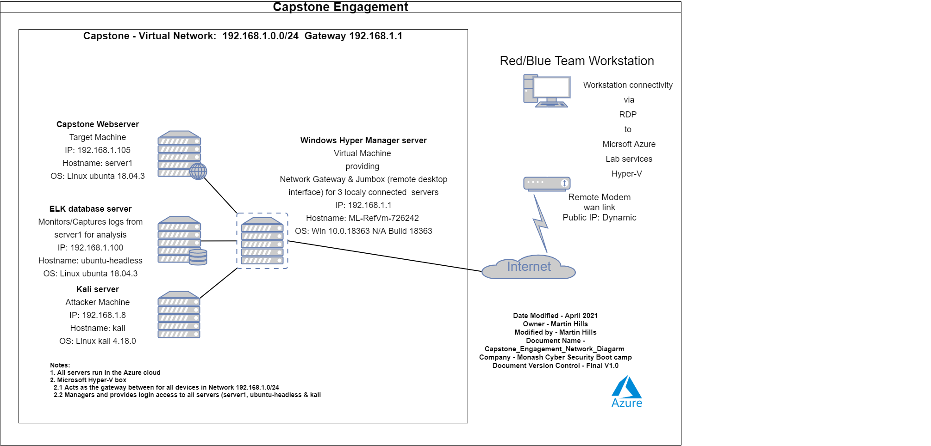
Network Topology
[Insert Here]
Use draw.io to create a diagram of the network.
Add your diagram to this slide and fill out the data in the sidebar.
Network
Address Range: 192.168.1.0/24
Netmask: 255.255.255.0
Gateway: 192.168.1.1
Machines
IPv4: 192.168.1.1
OS: Win 10.0.18363 N/A Build 18363
Hostname: ML-RefVm-726242 (Virtual machine)
IPv4: 192.168.1.8
OS: Linux kali 4.18.0
Hostname: kali (kali)
IPv4: 192.168.1.100
OS: Linux Ubuntu 18.04.3
Hostname: ubuntu-headless (ELK)
IPv4 192.168.1.105
OS: Linux Ubuntu 18.04.1
Hostname: server1 (Capstone )

Slide 5

Red Team
Security Assessment
‹#›

Slide 6
Recon: Describing the Target
Nmap identified the following hosts on the network:
Hostname | IP Address | Role on Network
ML-RefVm-726242 | 192.168.1.1 | Host server Windows Hyper-V Manager virtual server providing; (for 3 below listed servers) - Network Gateway - Remote desktop interface
kali | 192.168.1.8 | Attacker machine - kali server - Linux OS/device with security tools, used to launched attacks at the Capstone server for assessment and testing of vulnerabilities.
ubuntu-headless | 192.168.1.100 | Log server - elk server Linux OS/device aggregating logs from the server1, for analysis. (creates visualizations for application, infrastructure monitoring & security)
server1 | 192.168.1.105 | Target webserver - Capstone Corporate server Production web server being accessed and tested for vulnerabilities.

Slide 7
Vulnerability Assessment - Page 1
The assessment uncovered the following critical vulnerabilities in the target:
Vulnerability | Description | Impact
1. Open TCP Port 80 | Poorly configured and unsecured HTTP, allowing exploitation of Capstone server and sensitive data. | Allows anyone on the internet using a web browser (HTTP), access Capstones web server where they can find hidden directories, hidden files, usernames and sensitive data.
2. Inadequate login/password policies & practices | - Passwords are common and/or stored in in plain text. - No account lockout for failed number of login attempts. - Only single factor authentication used for logins. | Capstones web server Vulnerable, accessible and open to exploitation by those who can obtain passwords, (in minutes via brute force or other password cracking methods).
3. php Reverse Shell infiltratration: CVE-2019-13386 | server1 CentOS Web Panel 0.9.8.846 application requires updating/patching as is out of date, leaving the server exposed to exploitation. | A hidden action=9 feature in filemanager2.php allows attackers to execute a shell command, i.e., obtain a reverse shell with user privilege, gaining full access to server1

Slide 8
Vulnerability Assessment - Page 2
The assessment uncovered the following critical vulnerabilities in the target:
Vulnerability | Description | Impact
4. Poorly configured webdav | Allows unauthorized uploading of malicious payload/data to server1. | Allows remote attackers, the ability to execute malicious code on Capstones web server.
5. TCP 22 open | TCP 22 is used (ssh) for remote login to a device and if left open could be used for unauthorised access/malicious intent. | Unorthousred user can gain remote access to server1. Note: access to server1 via tcp 22 failed due to misconfigured config file, however this tcp should be closed in not required.
6. LDAPLoginModule implementation. CVE-2015-6524 | server1 - apache app requires updates/patching. It it out of date, leaving it exposed to exploitation. | Allows wildcard operators in usernames, which allows remote attackers to obtain Capstone user credentials, via a brute force attack.

Slide 9
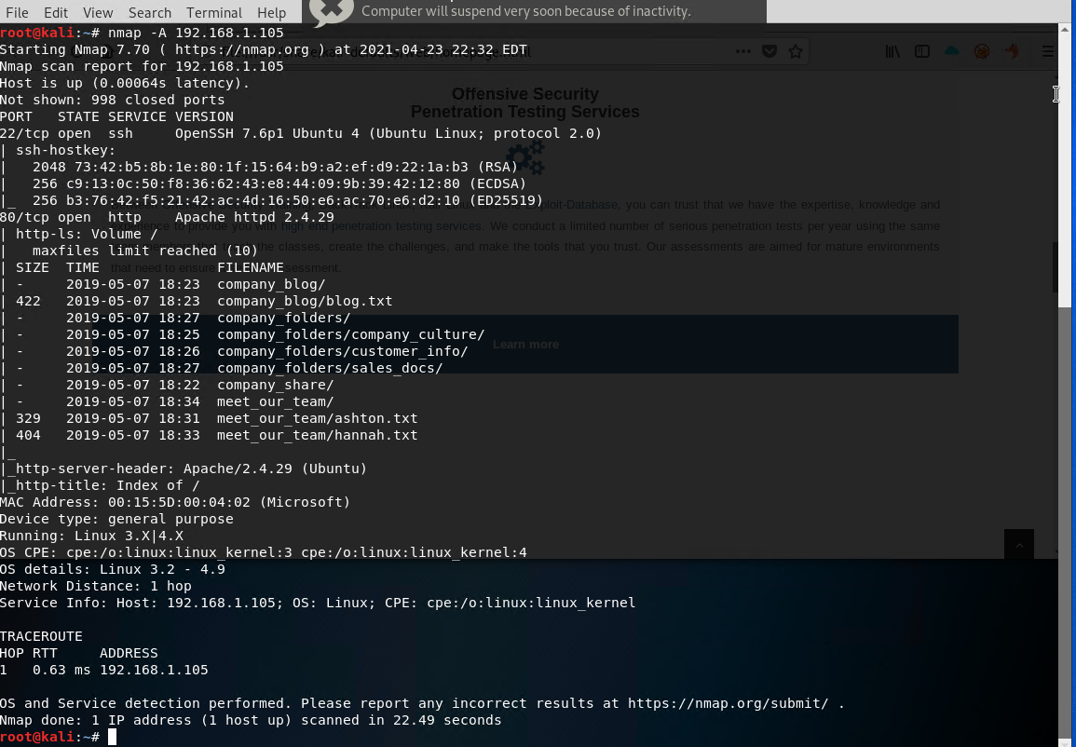
Exploitation: Open TCP Port 80
01
02
03
Tools & Processes
Used common command nmap to scan the
environment for open TCP ports.
Found the web server port 80
on 192.168.1.105
Achievements
This is not a exploit but rather a known method, used by anyone to determine system information like what TCP ports are open, running operating systems.
[INSERT: screenshot or command output illustrating the exploit.]

Slide 10
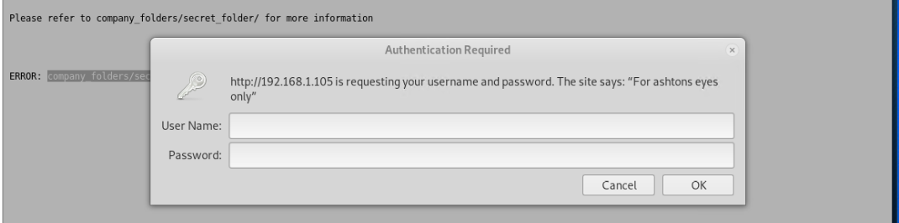
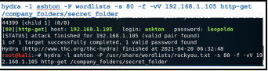
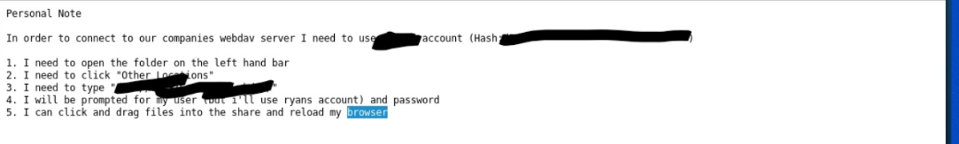
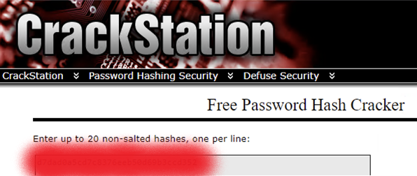
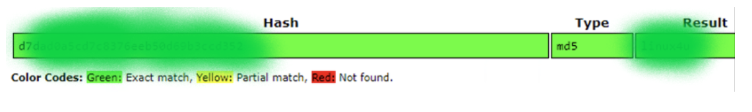
Exploitation: Inadequate login/password policies & practices
01
02
03
Tools & Processes
- Hydra was used with a wordlist to Brute Force
Ashton’s password.
- Crackstation used to unhash Ryan’s password.
Achievements
Due to poor password policies, Hydra was to able crack, (via brute force in less than 2 minutes), Ashton’s password.
Using Ashton’s password to access a secret folder, led us to Ryan’s hashed password, which Crackstation cracked, giving access to the webdav
folder.
Login hint (plain text)) “For Ashtons eyes only”
Simple password, no lockout & unlimited login attempts allows Hydra brute force password attack.
Able to see Ryan’s Hash’ed password.
Crackstation was able to unhash Ryans password.

Slide 11
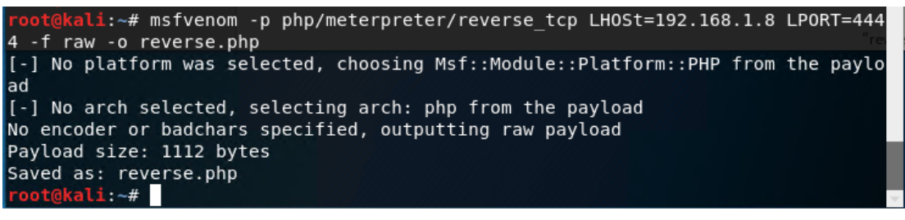
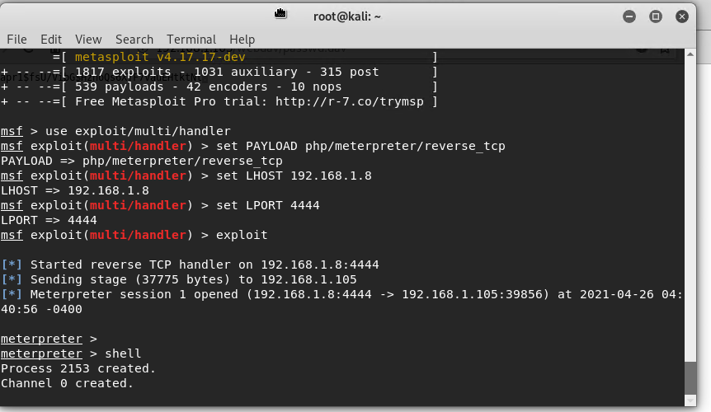
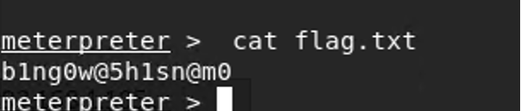
Exploitation: php Reverse Shell infiltratration:CVE-2019-13386
01
02
03
Tools & Processes
Used msfvenom to upload a
malicious file (reverse.php)
Used Webdav to put that file
on the server
Successfully execute the reverse shell payload using metaspolit to to create a
meterpreter session allowing the command shell to be run, giving system command access.
Achievements
After uploading & running the malicious file (reverse.php) on server1, we were able to
give ourselves a shell and execute commands.
msfvenom used to upload “reverse.php
meterpreter running and shell command executed
Using a linux command on server1

Slide 12
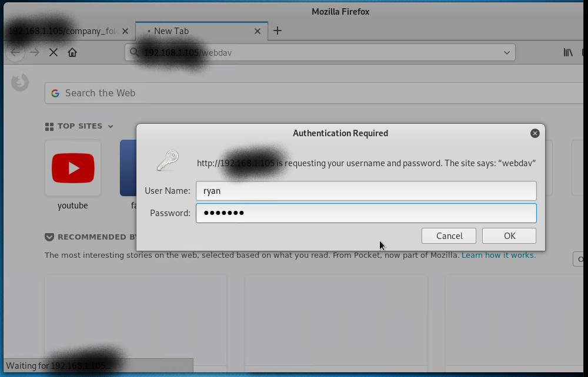
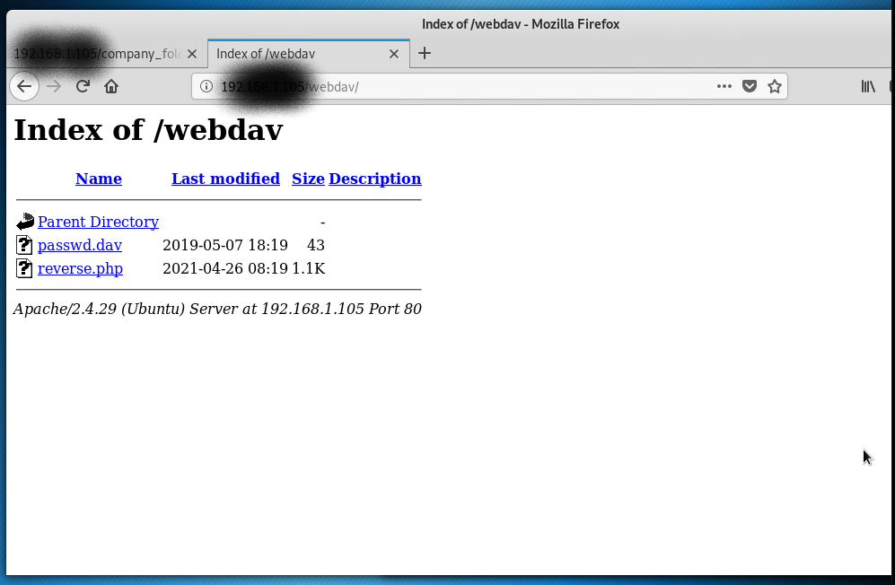
Exploitation: Poorly configured webdav
01
02
03
Tools & Processes
By using Ryan’s login/password details (gained by poor policies including the cracking of the hashed password) we were able to access the webdav server1 by entering
dav://192.168.1.105/webdav
from a web browser.
Achievements
Having access to the webdav server1 allowed us to upload a file reverse.php, containing a exploit that ultimately provided terminal access to server1 allowing commands to be executed on server1.
User ryan login request to webdav
Malicious reverse.php file, on server1 (notice

Slide 13

Blue Team
Log Analysis and Attack Characterization
‹#›

Slide 14
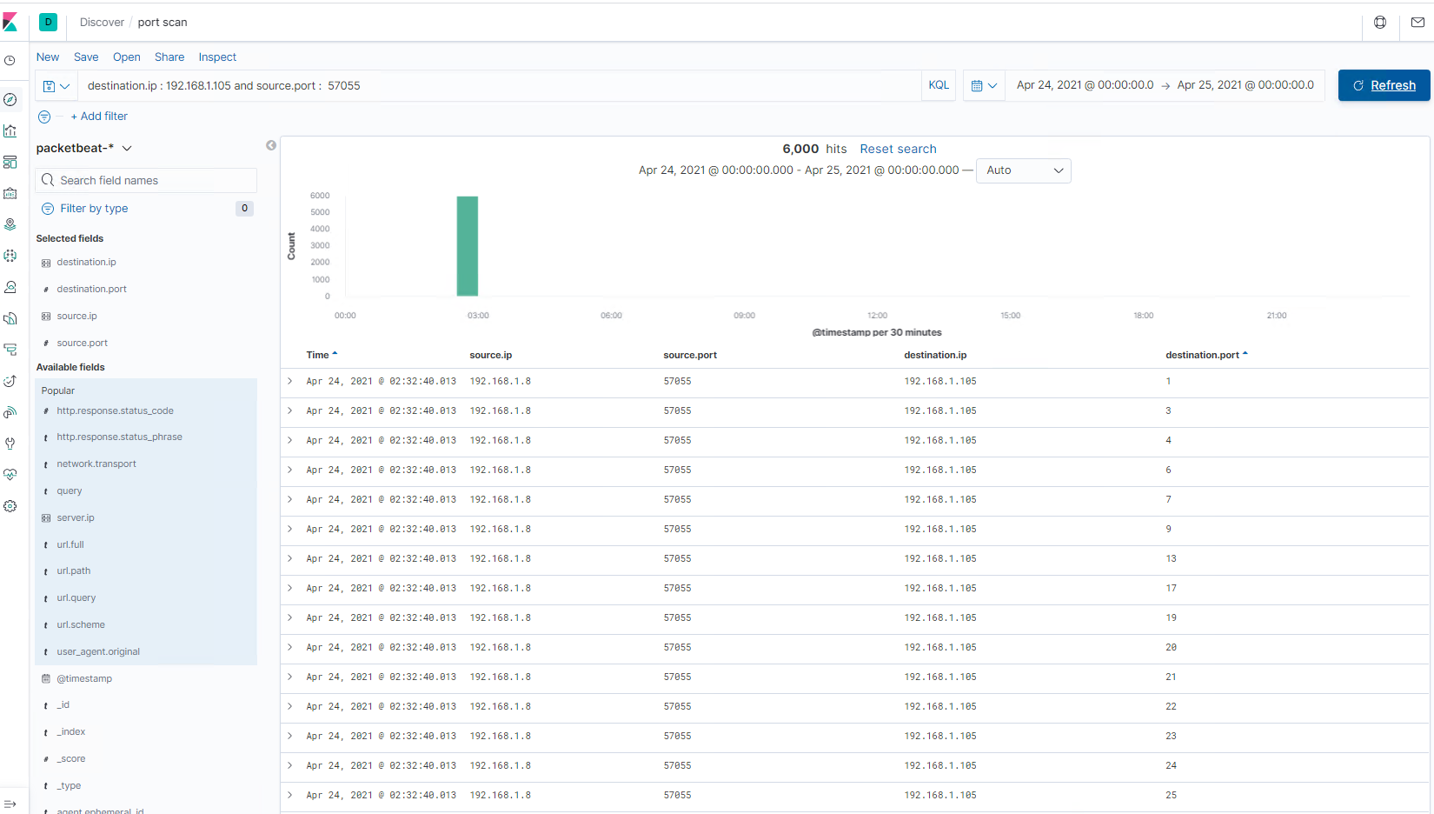

Analysis: Identifying the Port Scan
The port scan occur on the 24/04/2021 @ 02:32:40.013
6000 packets were sent from IP address 192.168.1.8 on TCP port 57055 to 192.167.1.105
There are a number of indicators, showing this was a port scan. The same source IP & source tcp port was used to poll the same destination IP but sequentially changed the destination TCP port number and this was performed within the same milliseconds (only an application or bot could perform this ) and you can see this by sorting the table by time. You’ll also notice the TCP ports are sequentially listed.
Search string used “ destination.ip : 192.168.1.105 and source.port : 57055

Slide 15
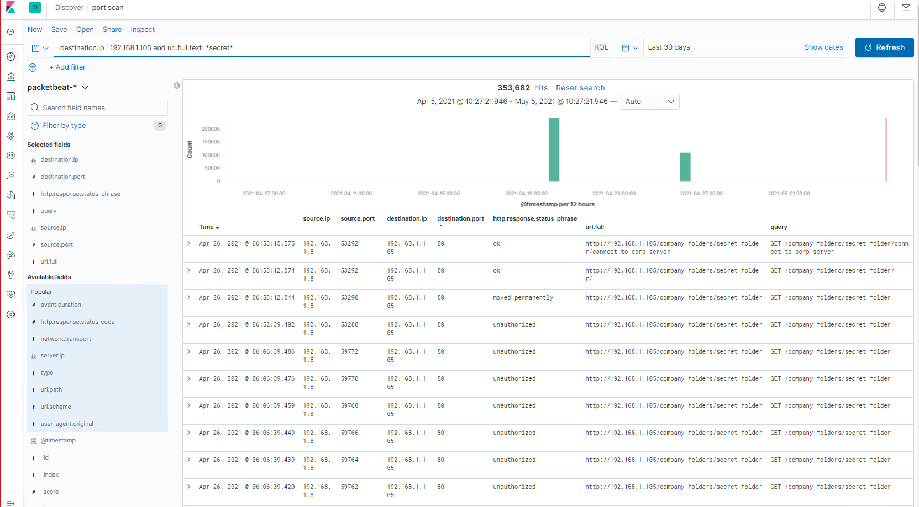
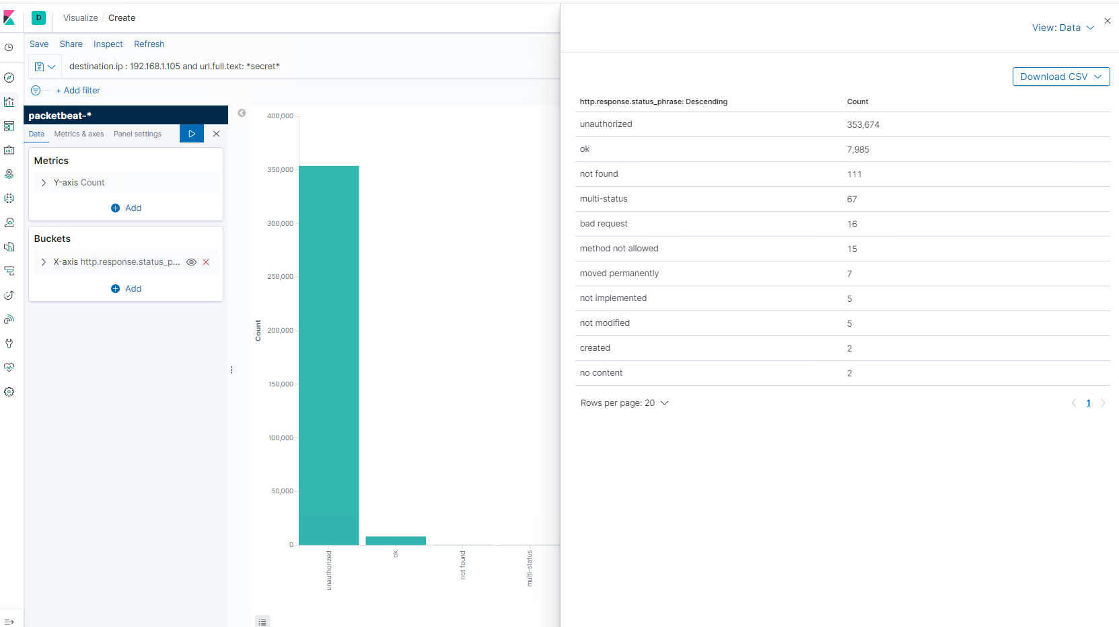
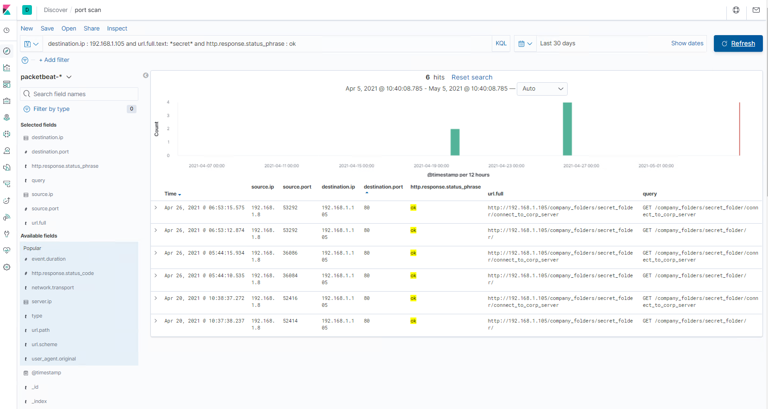
Analysis: Finding the Request for the Hidden Directory
The request for the Hidden Directory occurred twice however the first occurrence was on the 20/04/2021 @ 010:09:56.418.
There was a total request of 353,682 however the picture above/right gives a breakdown of each request type and the picture to the right indicates the number of times the file has been accessed.
The requested file was called “connect_to_the_corp_server” which contained details on how connect to the server, including using webdav. Page 14 has a screenshot of this file (Able to see Ryan’s Hash’ed password.)
Search string used “ destination.ip : 192.168.1.105 and url..full.text : *secret*

Slide 16
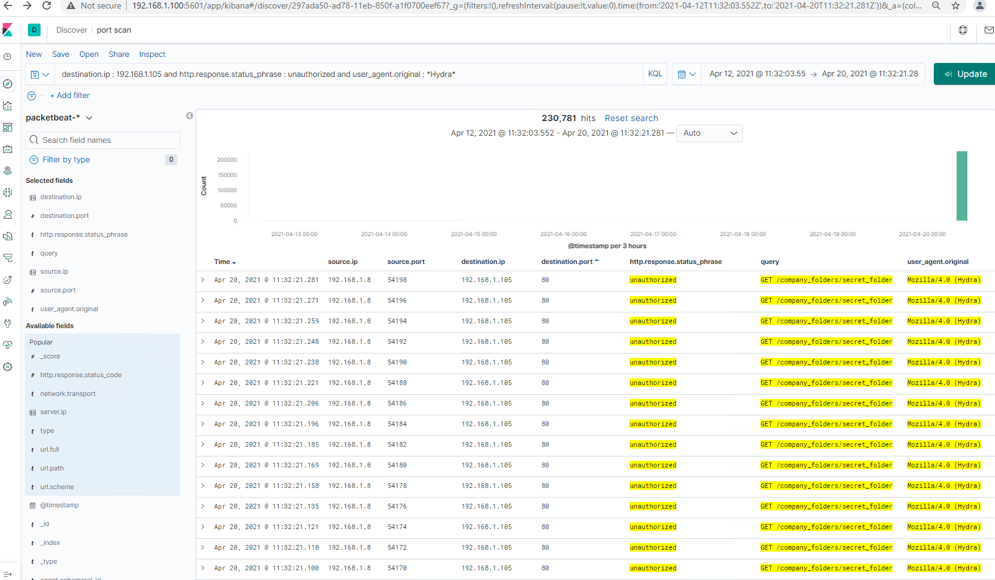
Analysis: Uncovering the Brute Force Attack
Hydra was used to brute force ashton’s password with 230,781 attempts made before a success on the 230,782 attempt.
Search string used “ destination.ip : 192.168.1.105 and http.response.status_phase : unauthorized and user_agent.original : *Hydra*”

Slide 17
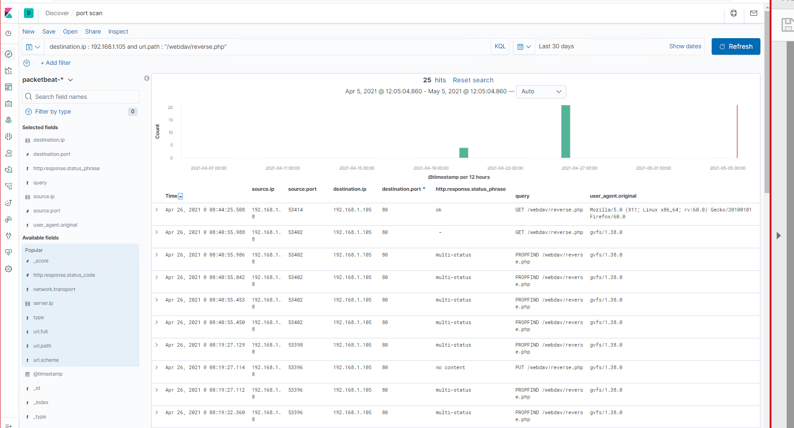
Analysis: Finding the WebDAV Connection
There were 25 requests made to the webdav DAV directory.
The file requested was the reverse.php file,used to launch the attack.
Search string used “ destination.ip : 192.168.1.105 and url.path : “/webdav/reverse.php”

Slide 18
Blue Team
Proposed Alarms and Mitigation Strategies
‹#›

Slide 19
Mitigation: Blocking the Port Scan - Page 1
Kibana can be configured to alert and action, base on an alarm.
An alarm for this port scan, would be to detect when;
- numerous TCP port requests are sent to a single destination IP address.
- occurs within a minimal time frame eg (less than 30 seconds per tcp port request).
Note: The alarm could also include the parameter, “from a single source IP address” however, at some point in the near future, someone will create a port scan that can be deployed from multiple IP addresses to a single destination IP address, scanning all TCP ports.frame than a bot or app could perform but not a human.
I would set a threshold of 4 scans to any TCP port on a single destination IP address with 30 milliseconds to avoid any false positives.
There are existing anti-port scanning tools on the Internet, that you can download and use (psad and portsentry) or use the recent iptables to record an IP that scans more than 10 ports in 30 seconds, and use the inotify-tools tool to monitor the iptables log in real-time. Once a new ip record is written to the iptables log file, use iptables blocks the source IP and prevents port scanning.

Slide 20
Mitigation: Blocking the Port Scan - Page 2
The next two pages Pages 2 & 3 provide the commands and scripts that can be created to harden the system.
iptables rule
Create a new script iptables.sh and execute this script.
IPT=”/sbin/iptables”
$IPT –delete-chain
$IPT –flush
#Default Policy
$IPT -P INPUT DROP
$IPT -P FORWARD DROP 
$IPT -P OUTPUT DROP
#INPUT Chain
$IPT -A INPUT -m state –state RELATED,ESTABLISHED -j ACCEPT
$IPT -A INPUT -p tcp -m tcp –dport 80 -j ACCEPT
$IPT -A INPUT -p tcp -m tcp –dport 22 -j ACCEPT
$IPT -A INPUT -i lo -j ACCEPT
$IPT -A INPUT -p icmp -m icmp –icmp-type 8 -j ACCEPT
$IPT -A INPUT -p icmp -m icmp –icmp-type 11 -j ACCEPT
$IPT -A INPUT -p tcp –syn -m recent –name portscan –rcheck –seconds 60 –hitcount 10 -j LOG
$IPT -A INPUT -p tcp –syn -m recent –name portscan –set -j DROP
#OUTPUT Chain
$IPT -A OUTPUT -m state –state RELATED,ESTABLISHED -j ACCEPT
$IPT -A OUTPUT -p udp -m udp –dport 53 -j ACCEPT
$IPT -A OUTPUT -o lo -j ACCEPT
$IPT -A OUTPUT -p icmp -m icmp –icmp-type 8 -j ACCEPT
$IPT -A OUTPUT -p icmp -m icmp –icmp-type 11 -j ACCEPT
#iptables save
service iptables save
service iptables restart

Slide 21
Mitigation: Blocking the Port Scan - Page 2
iptables log location change
Edit /etc/syslog.conf and add:
kern.warning /var/log/iptables.log
Restart syslog
/etc/init.d/syslog restart
Install inotify tool
yum install inotify-tools
Save the following code into prevent_portscan.sh
btime=600
while true;do
while inotifywait -q -q -e modify /var/log/iptables.log;do
ip=`tail -1 /var/log/iptables.log | awk -F”[ =]” ‘{print $13}’ | grep ‘\([0-9]\{1,3\}\.\)\{3\}[0-9]\{1,3\}’`
if test -z “`/sbin/iptables -nL | grep $ip`”;then
/sbin/iptables -I INPUT -s $ip -j DROP
{
sleep $btime && /sbin/iptables -D INPUT -s $ip -j DROP
} &
fi
done
done
Run the command to enable anti-port scanning
prevent_portscan.sh

Slide 22
Mitigation: Finding the Request for the Hidden Directory
An alarm can be set & configured in Kibana to alert and action on multiple attempts to access the hidden directory
“GET /compnay_folders/secret_folder” however a better solution would be capture all multiple attempts to access any folder/files by alarming on all
“unauthorized and/or failed login attempts.
eg alarm on
http.response.status_phrase = unauthorized
http.response.status_code = 401
Include in the alarm, a threshold of 3 unauthorized/401 (failed) attempts.
To block unwanted access to the systesecret_folder or another files/folder a combination of technical and administrative solutions should be used, eg.
- Account lockout after 3 failed attempts
- Max password age - change bi monthly
- Password complexity 8 to 16 multiple characters
- Multifactor authentication
Append file ‘/etc/pam.d/common-auth’ before all other lines with;
auth required pam_tally.so deny=3 unlock_time=10800
This locks user account after 3 failed attempts for 3 hours (10800 sec)

Slide 23
Mitigation: Preventing Brute Force Attacks
As in the previous slide, an alarm can be set & configured in Kibana to alert and action on multiple attempts to access files, folders or logins, however solutions can include, enabling a firewall, whitelisting approved, known IP addresses (might not cercanvent an internal attack from a known IP address) and/or capture all multiple attempts to access any folder/files/user logon by alarming on all
“unauthorized and/or failed login attempts.
http.response.status_phrase = unauthorized
http.response.status_code = 401
Include in the alarm, a threshold of 3 unauthorized/401 (failed) attempts.
To protect the server1 from brute-force attacks use the procedures, commands outlined in the above slide and/or use the following process,
1. Change SSH Port from 22 to something else (ie 2222). Majority of the brute-force attacks are targeted towards port 22 ...
2. Enable firewall. (iptable - default on ubuntu)
2. Disable password login for root.
3. User alternate account with sudo permission.
4. Keep your server and packages up-to date.
Command ‘/sudo iptables -L’ to list your current rules in iptables.
Commands
Iptables -A INPUT -m conntrack -ctstate ESTABLISHED,RELATED -j ACCEPT
Iptables -A INPUT -p tcp --dport 22 -s 102.168.1.8 -j ACCEPT
-A - Append this rule to a rule chain
-m conntrack - Allow filter rules to match based on connection state
--ctstate - Define the list of states for the rule to match on
-j - Jump to the specified target
-s --source - address & -p tcp --dport xx where xx is assigned ssh port

Slide 24
Mitigation: Detecting the WebDAV Connection
An alarm can be set & configured in Kibana to alert and action on any attempt to access the Webdav directory or for any non white listed IP address, attempting to access the Webdav directory.
A threshold of 0 for any non white listed IP’s or a threshold of 1 for any white listed IP however, due to the critical nature and the venrubaltir of Webdev, I would set a threshold of 0 for all IP’s.
All company’s, as part of their change processes should have a working CAB (Change advisory board) to ensure GRC (governance, risk, & compliance) of production environments .
The hypertext access file (commonly known as a .htaccess file) is a reliable configuration file that offers an easy way to set up your website’s details without having to modify the configuration files for your server. The file overrides many configuration settings making it an ideal tool for cache control, authorization, URL rewriting, and website optimization.
Is the Webdav directory required?
If ‘no’, remove.
Are there other directory/files/processor not required? If yes (not required), remove.
If WebDav, is required then;
Passwords for .htaccess are stored in the file; .htpasswd. Create this file and save it anywhere and not in the web directory (for security reasons).Write all the usernames and passwords of all the authorized users to be given permission to view some of the protected sections of your website. Once, you create all the passwords and usernames, add the code below into your /var/www/example.com/.htaccess file to activate the password function.
AuthUserFile /usr/local/username/safedirectory/.htpasswd
AuthGroupFile /dev/null
AuthName "Please Enter Password"
AuthType Basic
Require valid-user

Slide 25
Mitigation: Identifying Reverse Shell Uploads
An alarm must be set & configured in Kibana to alert and action on any attempt by a person/persons attempting to read/write/execute any folder/file that they are not authorised to.
I would set the threshold to 1 for any folder/file access (in case a user attempted access by mistake) however I would include an additional threshold of 2 folder/file access (within 12 hours) for an individual users/IP address, just incase the users is attempting to be covert in what they are doing.
Restrict, read, write and execute
permissions, to only those who need each to be able to read, or write or execute on a folder or file. Eg, if a users does not need to read or write or execute on a folder file, basis, access must be removed. This also helps eliminates an attacker to upload/execute a file/payload.
Using chmod -rwxdrxw---The most basic command is;
chmod -R xxx /?/? - where ? = /folder/(folder or file) and -rwxdrxw--- sets the read/write/execute permissions
chmod g+s /var/www/ 192.168.1.105
Set any folder/file created (within parent directory) to use parent directory permissions).
chown -R “user” /var/www /192.168.1.105/
Ssets user “user” as the owner of every folder/file in .var/www
chmod -R xxx /var/www /192.168.1.10 5
Set permissions. x (read) x (write) x (execute)

